Slide 1
VIVO ERP Integration
Sales and Consignments Reporting
22 November 2019

Slide 2
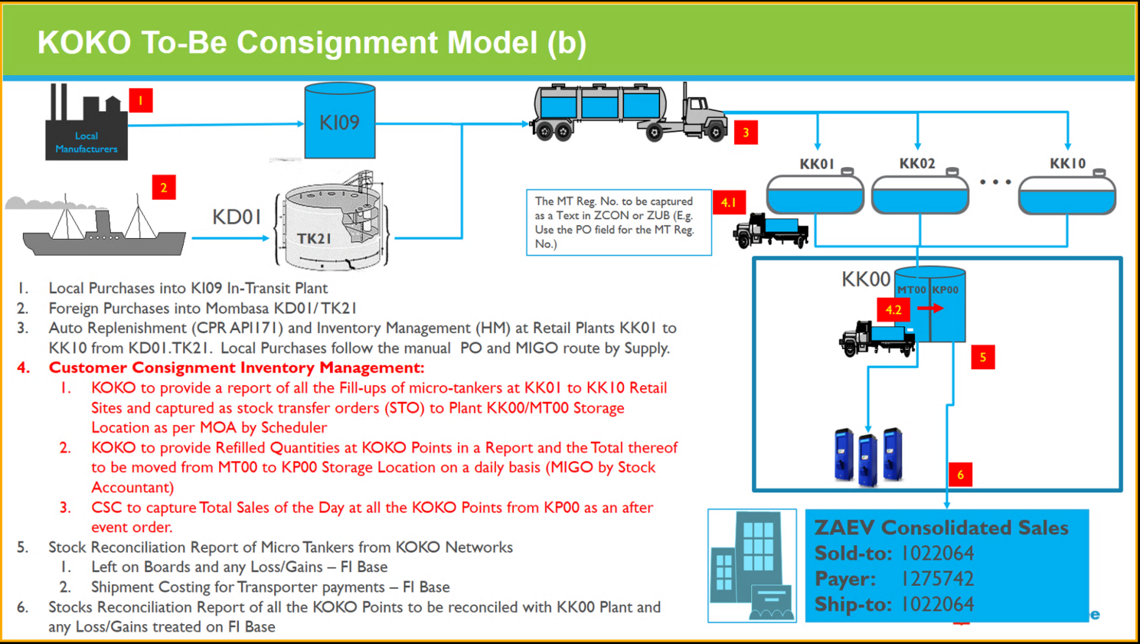

Slide 3



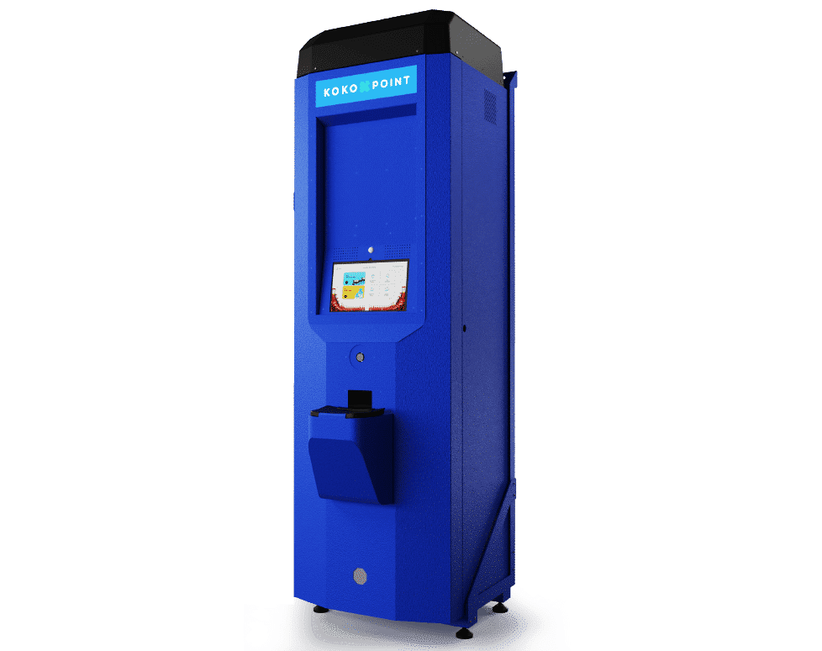
Network level reporting
API: 169
Manual report
API: 170
Uplift
Consignment
Sales
API: 171
MT00 (with reg as metadata)
ATG
Service Stations KK01 to KK10
Location: KK00
KPs:KP00
All KPs and MTs belong to 1 storage location in SAP KK00 with 2 storage locations MT00 and KP00 for MTs and KPs respectively
All fuel sold through KOKOpoints will be reported as coming from KK00
All fuel uplifts will be reported as going to KK00
Manual internal move in VIVO’s SAP for aggregate KP refills
This data will be shared manually by the stock accountants, in future we will revisit this decision

Slide 4
KOKO Process Mapping
KOKO Process | KOKO API | VIVO Interface | Comment
SDS Stock Levels | /sds_refill | API 171 | Single line per depot for every day
MT refills | /mt_refill | API 169 | Single line for every transaction
KP refills | /kp_refill | None | Manual report sent by stock accountants for the single transaction
KP Sales | /fuel_sale | API 170 | Aggregate across the network per day

Slide 5
KOKO Process Mapping (previous model)
KOKO Process | KOKO API | VIVO Interface | Comment
SDS Stock Levels | /sds_refill | API 171 | Single line per depot for every day
MT refills | /mt_refill | None | Manual report sent by stock accountants
KP refills | /kp_refill | API 169 | KP refills to be mapped to a source depot. Aggregate a depot per day.
KP Sales | /fuel_sale | API 170 | Fuel sales to be mapped to source depot. Aggregate a depot per day.
CANCELLED

Slide 6
KOKO API /sds_refill
Technical Summary
Business Logic Summary
API URL: /v1/sds_refill
Method: GET
Response Parameters: 171_mapping sheet
Max Records 1000
Data Refresh: Daily
IP based state management for records
Transmits the current stock level for the Depots (service stations)
Has 1 record per Depot (service station)
Every record should highlight
Current stock level
% of the tank with stock
Timestamp of last uplift(MT refill) from the Depot (service station)
Static and mapping data to VIVO’s system

Slide 7
KOKO API /mt_refill
Technical Summary
Business Logic Summary
API URL: /v1/mt_refill
Method: GET
Response Parameters: 169_mapping sheet
Max Records 1000
Data Refresh: Daily
IP based state management for records
Transmits all of the fuel uplifts (MT Refill) from KOKO’s Depots (Service station)
Has a transaction per uplift (MT refill)
Every transaction should highlight
Loaded quantity
Depot(service station) the fuel was lifted from
Registration of the microtanker that picked up the load
Timestamp of the transaction
Static and mapping data to VIVO’s system

Slide 8
KOKO API /fuel_sale
Technical Summary
Business Logic Summary
API URL: /v1/fuel_sale
Method: GET
Response Parameters: 170 mapping sheet
Max Records 1000
Data Refresh: Daily
IP based state management for records
Transmits an aggregate of all of the fuel sales from KOKOpoints (KPs) to customers daily
Has 1 transaction for all of the sales in a day
The transaction should highlight
Total sold quantity
Date of the transaction
Static and mapping data to VIVO’s system

